Slide 1

MATH 801: Complex Variables and Transform Methods
Md. Toriqul Islam
Lecturer in Mathematics
Basic Science Division
World University of Bangladesh

Slide 2
Lecture Outline
The Real Number System
Graphical Representation of Real Numbers
The Complex Number System
Fundamental Operations with Complex Numbers
Week 1 | MATH 704 | 1/12

Slide 3
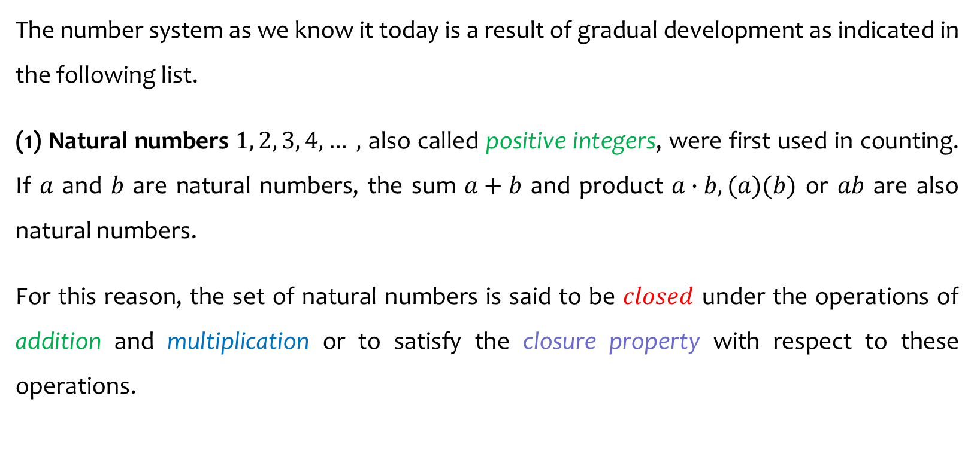
The Real Number System
The number system as we know it today is a result of gradual development as indicated in the following list.
(1) Natural numbers $1, 2, 3, 4, … ,$ also called positive integers, were first used in counting. If $a$ and $b$ are natural numbers, the sum $a+b$ and product $a∙b, (a)(b)$ or $ab$ are also natural numbers.
For this reason, the set of natural numbers is said to be $closed$ under the operations of addition and multiplication or to satisfy the closure property with respect to these operations.
Week 1 | MATH 704 | 2/12

Slide 4
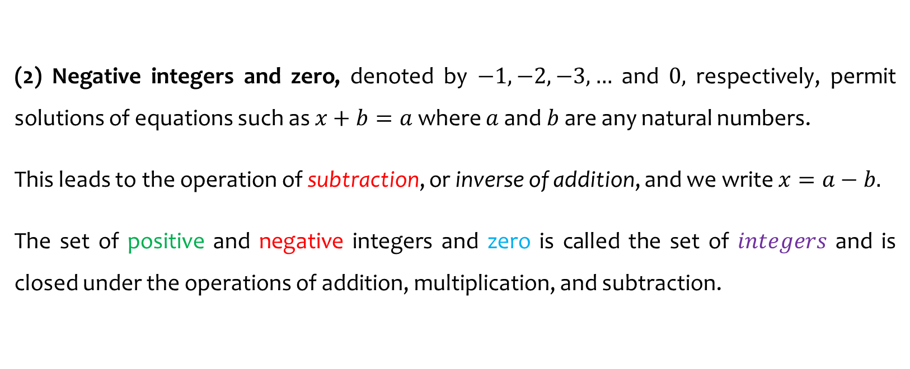
The Real Number System
(2) Negative integers and zero, denoted by $−1, −2, −3, …$ and $0,$ respectively, permit solutions of equations such as $x+b=a$ where $a$ and $b$ are any natural numbers.
This leads to the operation of subtraction, or inverse of addition, and we write $x=a−b.$
The set of positive and negative integers and zero is called the set of $integers$ and is closed under the operations of addition, multiplication, and subtraction.
Week 1 | MATH 704 | 3/12

Slide 5
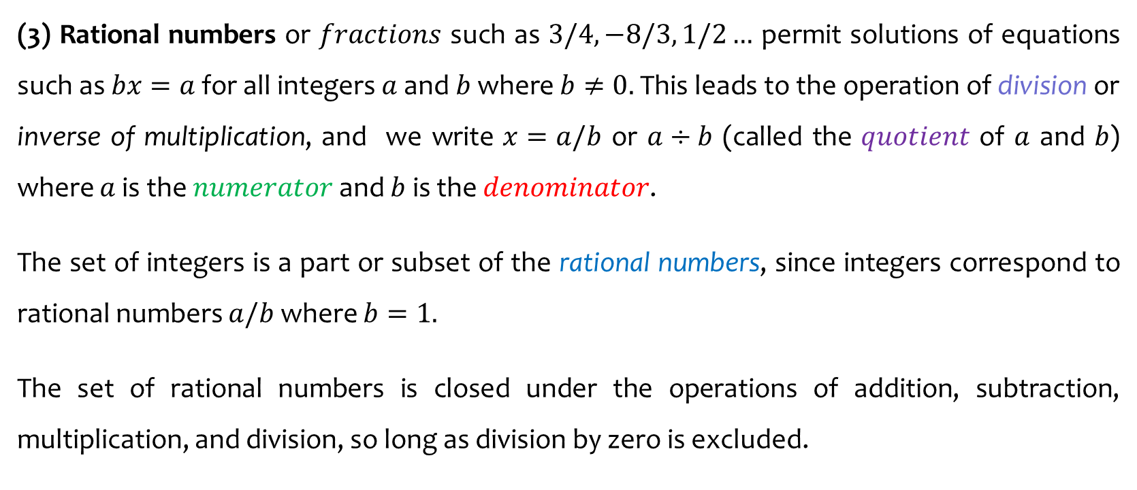
The Real Number System
(3) Rational numbers or $fractions$ such as $3/4, −8/3, 1/2…$ permit solutions of equations such as $bx=a$ for all integers $a$ and $b$ where $b≠0.$ This leads to the operation of division or inverse of multiplication, and we write $x=a/b$ or $a÷b$ (called the $quotient$ of $a$ and $b$) where $a$ is the $numerator$ and $b$ is the $denominator$.
The set of integers is a part or subset of the rational numbers, since integers correspond to rational numbers $a/b$ where $b=1.$
The set of rational numbers is closed under the operations of addition, subtraction, multiplication, and division, so long as division by zero is excluded.
Week 1 | MATH 704 | 4/12

Slide 6
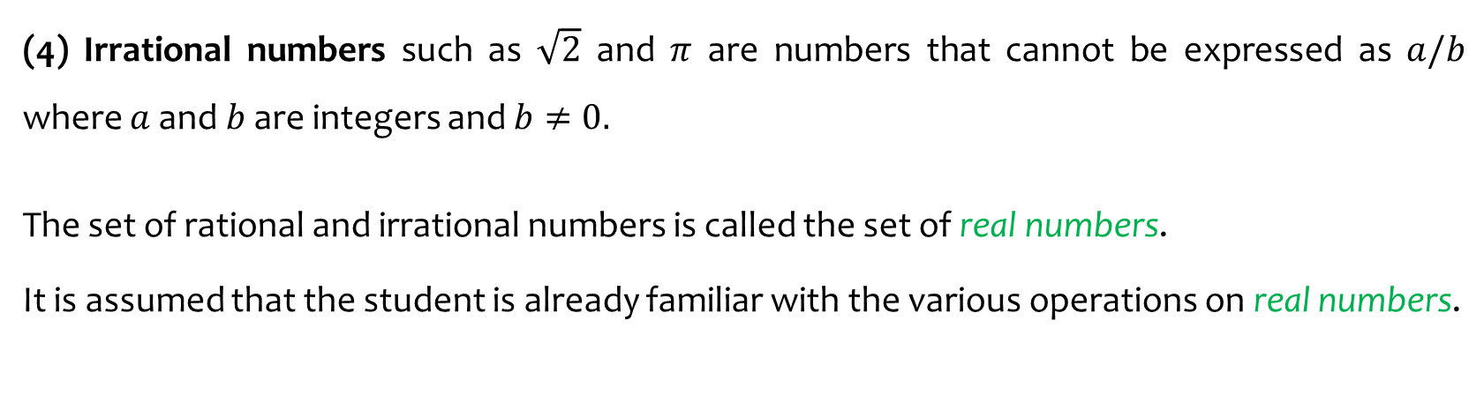
The Real Number System
(4) Irrational numbers such as $\sqrt{2}$ and $π$ are numbers that cannot be expressed as $a/b$ where $a$ and $b$ are integers and $b≠0.$
The set of rational and irrational numbers is called the set of real numbers.
It is assumed that the student is already familiar with the various operations on real numbers.
Week 1 | MATH 704 | 5/12

Slide 7
Graphical Representation of Real Numbers
Real numbers can be represented by points on a line called the real axis, as indicated in the following figure. The point corresponding to zero is called the origin.
Figure: Number Line
Week 1 | MATH 704 | 6/12

Slide 8
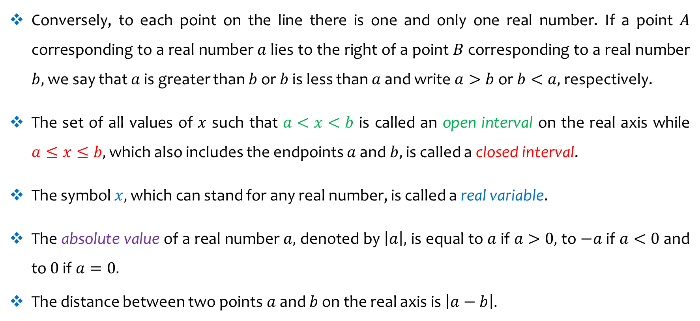
Graphical Representation of Real Numbers
Conversely, to each point on the line there is one and only one real number. If a point $A$ corresponding to a real number $a$ lies to the right of a point $B$ corresponding to a real number $b,$ we say that $a$ is greater than $b$ or $b$ is less than $a$ and write $a>b$ or $b<a,$ respectively.
The set of all values of $x$ such that $a<x<b$ is called an open interval on the real axis while $a≤x≤b,$ which also includes the endpoints $a$ and $b,$ is called a closed interval.
The symbol $x,$ which can stand for any real number, is called a real variable.
The absolute value of a real number $a,$ denoted by $\left|a\right|,$ is equal to $a$ if $a>0,$ to $−a$ if $a<0$ and to $0$ if $a=0.$
The distance between two points $a$ and $b$ on the real axis is $\left|a−b\right|.$
Week 1 | MATH 704 | 7/12

Slide 9
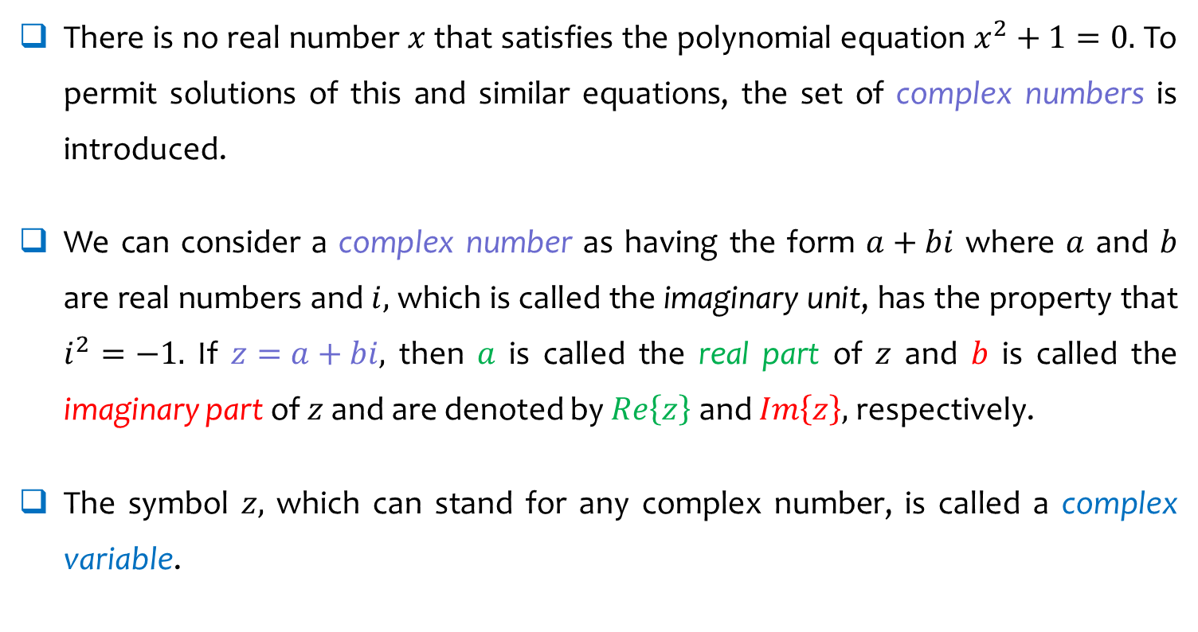
The Complex Number System
There is no real number $x$ that satisfies the polynomial equation $x^{2}+1=0.$ To permit solutions of this and similar equations, the set of complex numbers is introduced.
We can consider a complex number as having the form $a+bi$ where $a$ and $b$ are real numbers and $i,$ which is called the imaginary unit, has the property that $i^{2}=−1.$ If $z=a+bi,$ then $a$ is called the real part of $z$ and $b$ is called the imaginary part of $z$ and are denoted by $Re\left\{z\right\}$ and $Im\left\{z\right\},$ respectively.
The symbol $z,$ which can stand for any complex number, is called a complex variable.
Week 1 | MATH 704 | 8/12

Slide 10
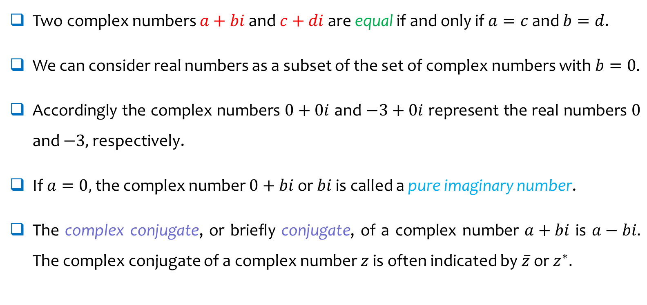
The Complex Number System
Two complex numbers $a+bi$ and $c+di$ are equal if and only if $a=c$ and $b=d$.
We can consider real numbers as a subset of the set of complex numbers with $b=0.$
Accordingly the complex numbers $0+0i$ and $−3+0i$ represent the real numbers $0$ and $−3,$ respectively.
If $a=0,$ the complex number $0+bi$ or $bi$ is called a pure imaginary number.
The complex conjugate, or briefly conjugate, of a complex number $a+bi$ is $a−bi.$ The complex conjugate of a complex number $z$ is often indicated by $\overline{z}$ or $z^{∗}.$
Week 1 | MATH 704 | 9/12

Slide 11
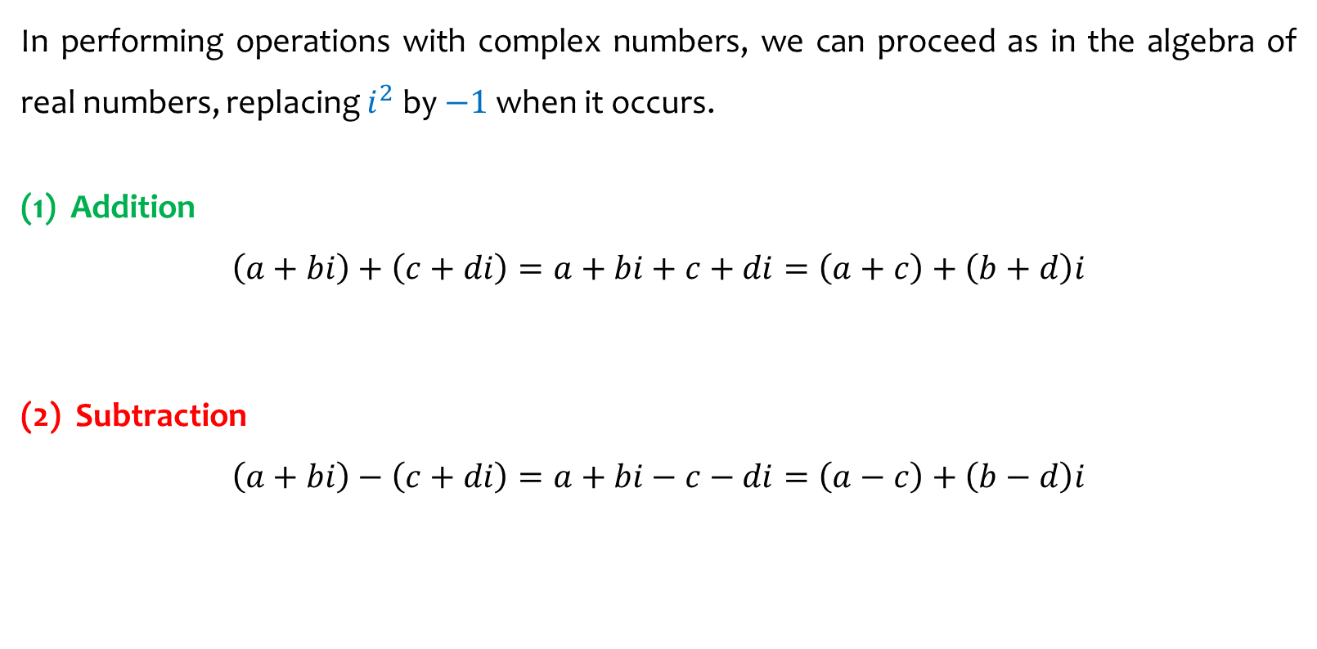
Fundamental Operations with Complex Numbers
In performing operations with complex numbers, we can proceed as in the algebra of real numbers, replacing $i^{2}$ by $−1$ when it occurs.
(1) Addition
$$\left(a+bi\right)+\left(c+di\right)=a+bi+c+di=\left(a+c\right)+\left(b+d\right)i$$
(2) Subtraction
$$\left(a+bi\right)−\left(c+di\right)=a+bi−c−di=\left(a−c\right)+\left(b−d\right)i$$
Week 1 | MATH 704 | 10/12

Slide 12
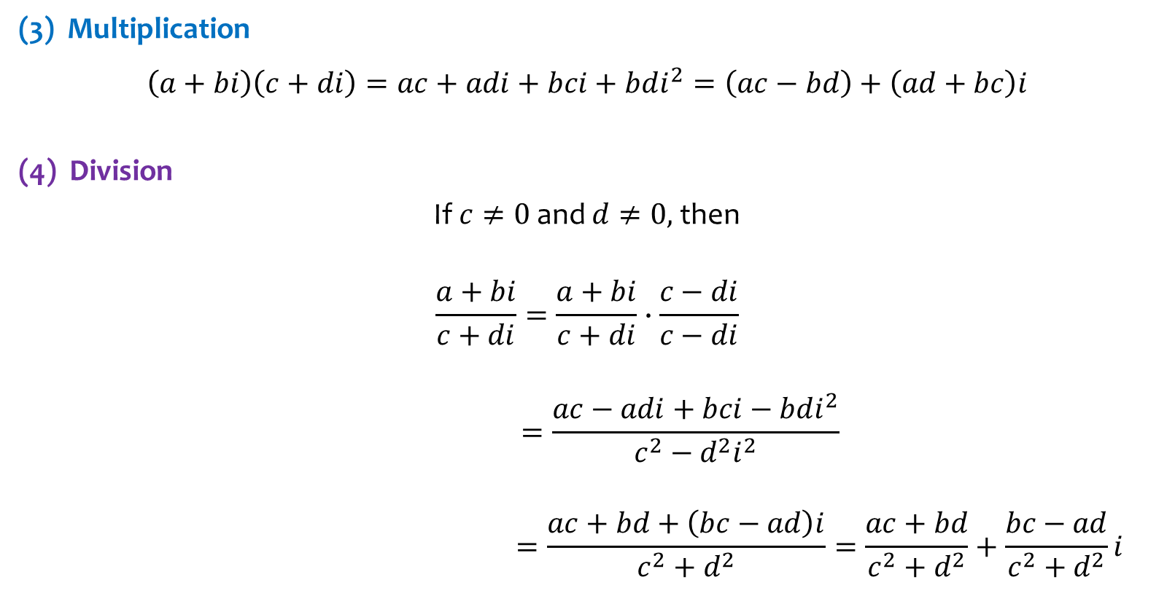
Fundamental Operations with Complex Numbers
(3) Multiplication
$$\left(a+bi\right)\left(c+di\right)=ac+adi+bci+bdi^{2}=\left(ac−bd\right)+\left(ad+bc\right)i$$
(4) Division
If $c≠0$ and $d≠0,$ then
$$\frac{a+bi}{c+di}=\frac{a+bi}{c+di}∙\frac{c−di}{c−di}$$
$$=\frac{ac−adi+bci−bdi^{2}}{c^{2}−d^{2}i^{2}}$$
$$=\frac{ac+bd+\left(bc−ad\right)i}{c^{2}+d^{2}}=\frac{ac+bd}{c^{2}+d^{2}}+\frac{bc−ad}{c^{2}+d^{2}}i$$
Week 1 | MATH 704 | 11/12

Slide 13
Next Lecture
Graphical Representation of Complex Numbers
Polar Form of Complex Numbers
De Moivre’s Theorem
Vector Interpolation of Complex Number
Week 1 | MATH 704 | 12/12

